Slide 1
Network Manager
Part – 1: Network Consolidated

Slide 2
Overview
Background
Approach :
Introduce Simple Features File Format
Work with an example
My Criteria Algorithm
(criteria used for identifying related links)
Intro to Data Structures & Algorithms :
Intro to Algorithm
Intro to Data Structure
Graph Theory and its Search Algorithms
Prepare Data
Input Data Issues
Program Internals: Features to Handle bad data
(user makes mistakes, program understands the intent)

Slide 3
Background
1. Network Manager
2. Multi-Resolution
3. Subarea Detailed Network

Slide 4
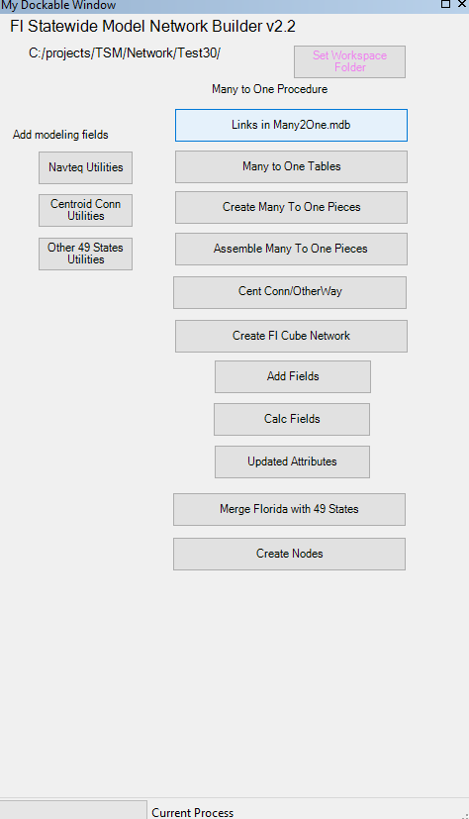
Network Development
Network Manager
2011 -Navteq
2019 -Navteq
Geo Master Network
Network Attributes
Manual Process
FLSWM Network
All District TIPS
Future Network
GeoMaster Network
Every 5 Years
(2020, 2025 ..2045)
Every 5 Years
(2020, 2025 ..2045)
Many-to-One Tool
Alt -1
Project - 1 Network
Future Prj -1
Alt -1
Alt -2
(2020)
Alt -3
Opens in 2020
Future Prj - 2 Alt-4b + Prj1 Alt-1
Alt -1
Project - 2 Network
Alt -3a
(2025)
Alt -4b
Opens in 2025
Complete
Run Many-to-One Tool for project linework merging and consolidating
Base Network
Notes:
The base network is developed from 2011 Navteq and porting 2015 linework from 2019 Navteq sources. Some of the modeling network attributes such as area type, facility types are ported from Statewide Model Network.
The first step is to convert Navteq into linear system and then consolidate network links based on Zone system. This is a manual process and reduces total links from 2 Million to 300K.
Then an automated process “Many-to-One” Tool is run to merge 300k links based on link information. In this process centroid connectors are also merged along with US networks outside FL state. The US network outside the state is required for long distance travel. It includes network by air, rail and road (check if CUBE US carries all modes?)
This produces a base network
However we also need Network Manager:
The network manager tool allows users to add projects to the base network to create future year networks.
Ideally, if all district TIP and work program projects area available in geocoded format with all required network attributes (speed, lanes, type, capacity), we can simply add these by their respective years to develop future year networks.
In case we don’t have all the line work but if we have future year networks then we can diff it with base to create a list of projects by year.
For projects, each project can consists of several alternatives and so its best to carry each project as a file with alternatives as features (project as container and alternative as items)
Based on the year, user can simply add all the projects that should be included in the future year project lists.

Slide 5
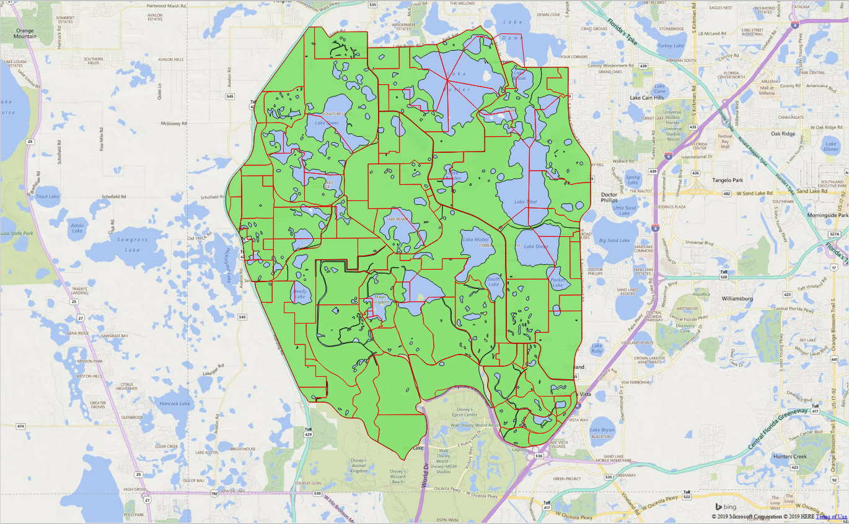
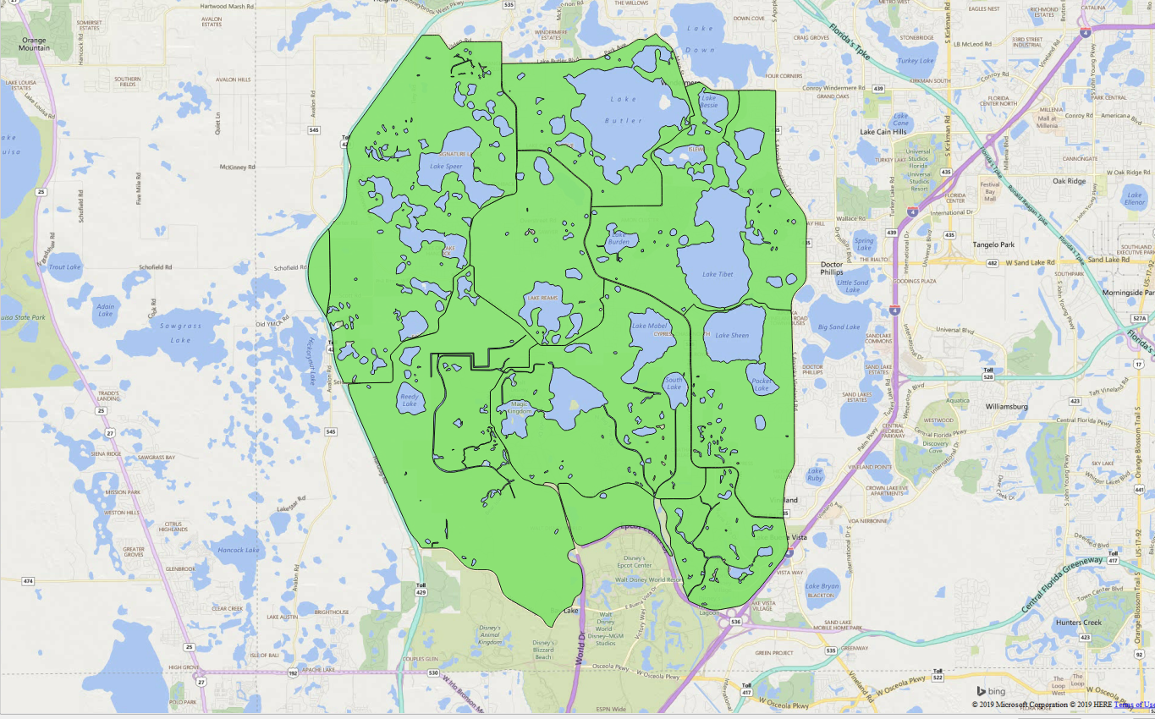
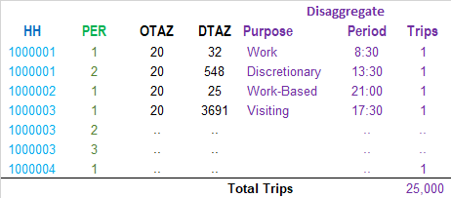
Multi-Resolution: Import Regional TAZ and Networks
POPSYN / Demand Side: 10 TSM Zones map to 100 CFRPM zones
201 -----
201 -----
201
20
Splitting here means, recoding OTAZ, DTAZ based on new zones (new splits).
Say new Zone 20 is split to 20 and 201:
Just change the OTAZ to Osub on records that represent the new zone (proportional to geographies or more advanced level).
Notes:
Lets say we have a TSM subarea with 10 large zones consisting about 25k trips. This is a real zone systems (area between SR -429, Turnpike, I-4 and Disney) cover by only 10 TSM zones. Instead of traditional trip table of 10 x 10 OD with 25K trips, we now have a trip list with 25K rows with each row representing one trip.
Now say we need to split this into 100 zones (which are CFRPM zones for this area in new CFRPM v7 model). It’s pretty simple to do. Just change the O and D zones to Osub and Dsub zones
There are far more advanced methods than just recoding O and D zones. In one method, then entire model is re-run from popsyn to here when the socio-demographics are changed. Same thing on destination end, when we add more destinations the model needs to re-run at the subarea level and the resulting trips need to be scaled back to original large system trips to ensure consistency.

Slide 6
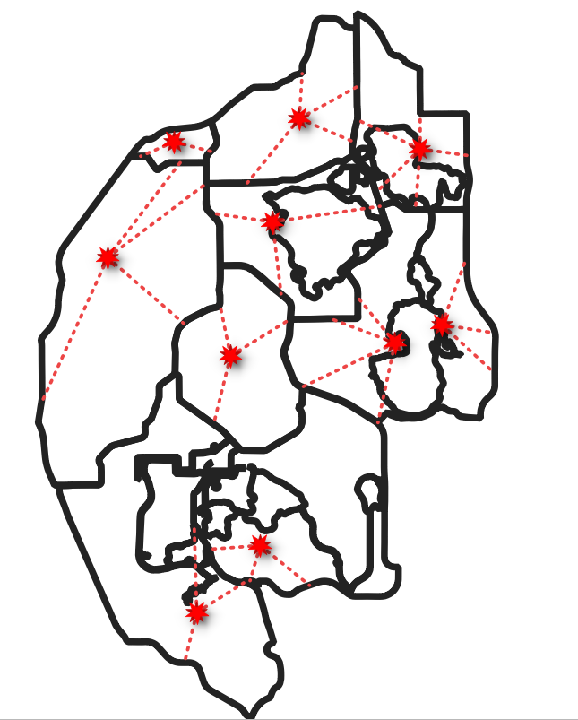
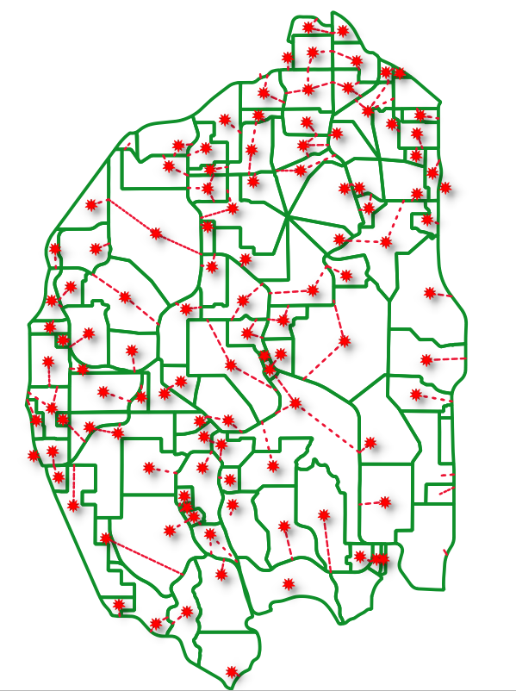
Multi-Resolution: Import Regional TAZ and Networks
10 TSM Zones
110 CFRPM zones
Process:
Discard 10 TSM
Centroids
Centroid connectors
Import 110 CFRPM
Centroids
Centroid connectors
3. Run Many-to-One tool
Notes:
Lets say we have a TSM subarea with 10 large zones consisting about 25k trips. This is a real zone systems (area between SR -429, Turnpike, I-4 and Disney) cover by only 10 TSM zones. Instead of traditional trip table of 10 x 10 OD with 25K trips, we now have a trip list with 25K rows with each row representing one trip.
Now say we need to split this into 100 zones (which are CFRPM zones for this area in new CFRPM v7 model). It’s pretty simple to do. Just change the O and D zones to Osub and Dsub zones
There are far more advanced methods than just recoding O and D zones. In one method, then entire model is re-run from popsyn to here when the socio-demographics are changed. Same thing on destination end, when we add more destinations the model needs to re-run at the subarea level and the resulting trips need to be scaled back to original large system trips to ensure consistency.

Slide 7
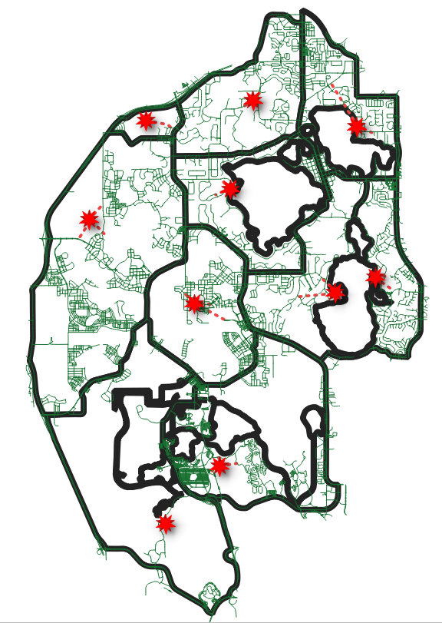
Multi-Resolution: Add Detailed Subarea Network
10 TSM Zones
Detailed Subarea Network zones
Process:
Discard 10 TSM
Centroid connectors
Import Navteq local roads
Run aggregate process to generalize local streets to navigable / assignable links. There by adding more major streets to the network
Create new centroid connectors to new generalized roadways.
5. Run Many-to-One tool
Notes:
Lets say we have a TSM subarea with 10 large zones consisting about 25k trips. This is a real zone systems (area between SR -429, Turnpike, I-4 and Disney) cover by only 10 TSM zones. Instead of traditional trip table of 10 x 10 OD with 25K trips, we now have a trip list with 25K rows with each row representing one trip.
Now say we need to split this into 100 zones (which are CFRPM zones for this area in new CFRPM v7 model). It’s pretty simple to do. Just change the O and D zones to Osub and Dsub zones
There are far more advanced methods than just recoding O and D zones. In one method, then entire model is re-run from popsyn to here when the socio-demographics are changed. Same thing on destination end, when we add more destinations the model needs to re-run at the subarea level and the resulting trips need to be scaled back to original large system trips to ensure consistency.

Slide 8
Current Many-to-One
Challenges:
It’s a ArcGIS Add-Ins (limited to PCs , requires license, version compatibility issues)
Rigid data structure: Limited to current inputs (GeoMaster, Zonal Connectors, HwyNodeIDs, Centroids),
Currently offers no callbacks or API to outside ArcGIS. Requires recoding in ArcPy and a wrapper to receive call from external programs
Not database driven, not scalable
Runtime is an issue
Solution: Write a brandnew tool that offers:
Open Source software (no dependencies, costs , permissions to install and use)
Flexible data structure, should work with wide range of data types (Shape Files, SQL Databases, Geo Databases, Servers)
API framework to outside programs, where heavy lift functions exists here but can be called from anywhere or any software.
Scalability, meaning doubling the network should not result in more than twice the runtime (at the most). Linearly proportional not exponential.
Quick Runtime
Notes:
Lets say we have a TSM subarea with 10 large zones consisting about 25k trips. This is a real zone systems (area between SR -429, Turnpike, I-4 and Disney) cover by only 10 TSM zones. Instead of traditional trip table of 10 x 10 OD with 25K trips, we now have a trip list with 25K rows with each row representing one trip.
Now say we need to split this into 100 zones (which are CFRPM zones for this area in new CFRPM v7 model). It’s pretty simple to do. Just change the O and D zones to Osub and Dsub zones
There are far more advanced methods than just recoding O and D zones. In one method, then entire model is re-run from popsyn to here when the socio-demographics are changed. Same thing on destination end, when we add more destinations the model needs to re-run at the subarea level and the resulting trips need to be scaled back to original large system trips to ensure consistency.

Slide 9
Approach: What’s is that we want to do
Introduce Simple Features File Format
Work with an example

Slide 10
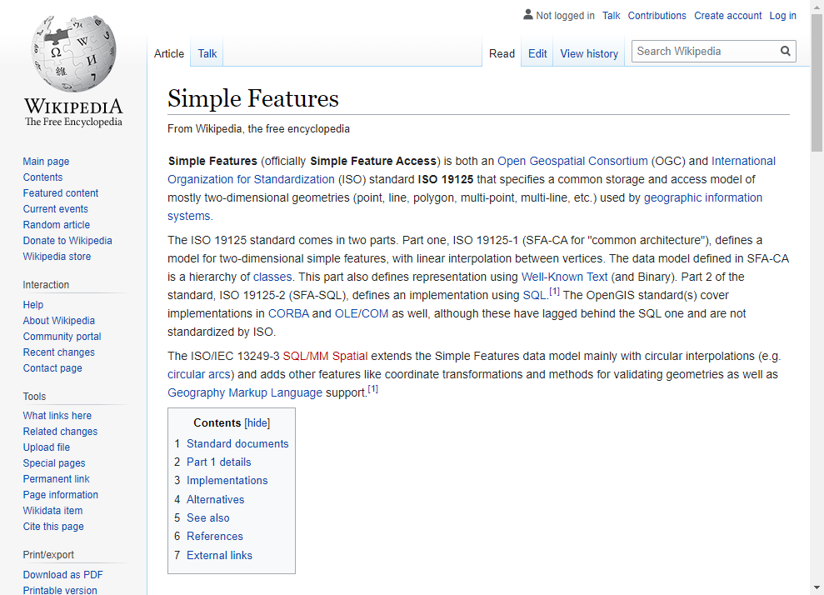
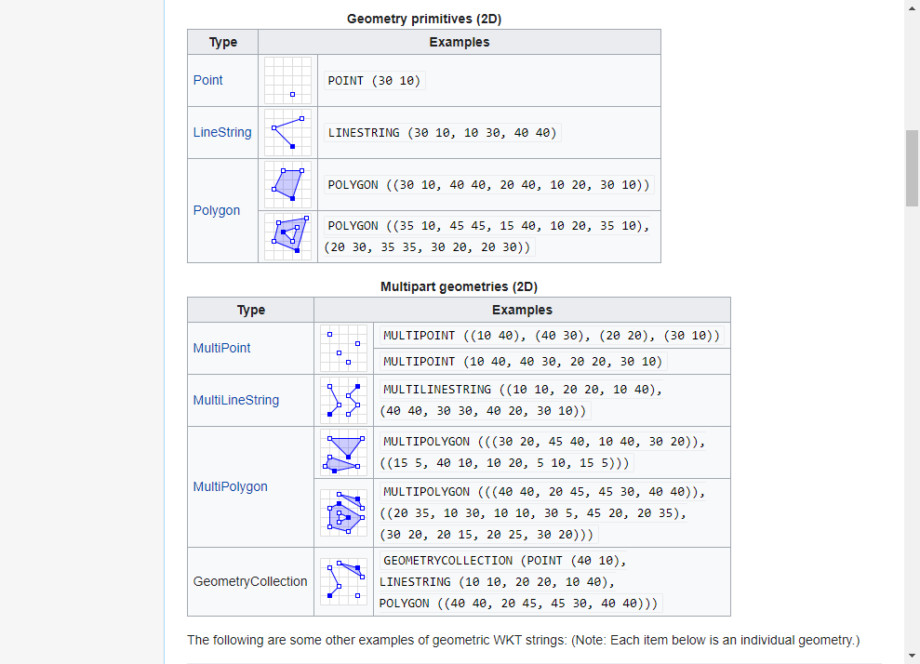
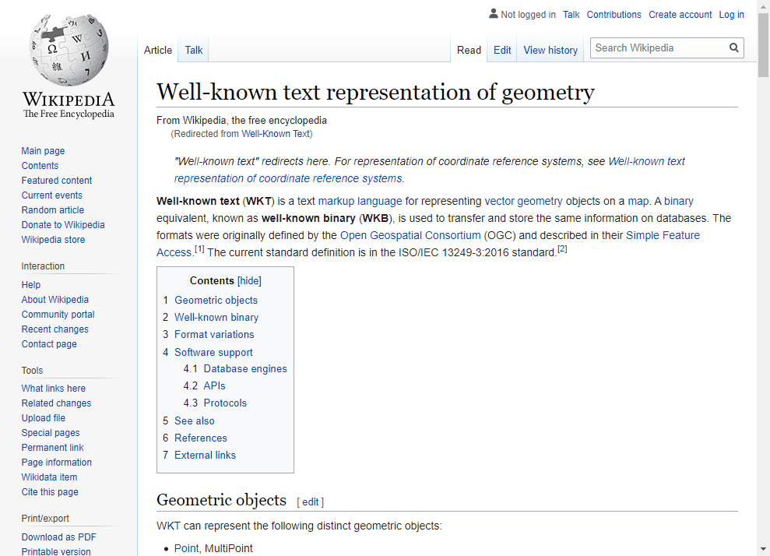
Simple Feature Format ?

Slide 11
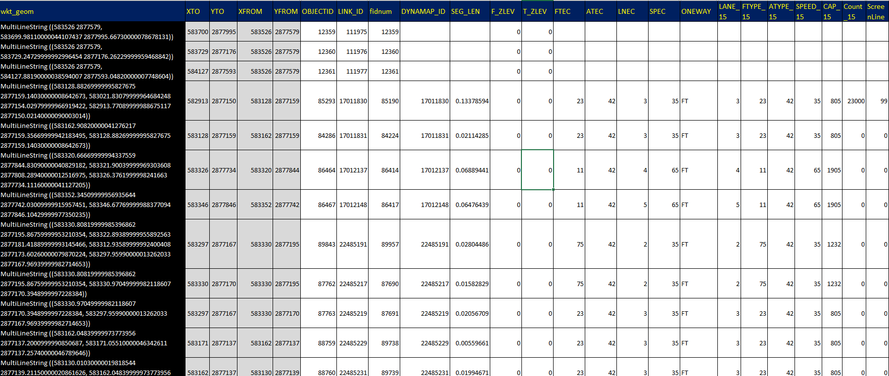
Simple Feature: Well Known Text (wkt) Format ?
GIS Internals: FROM / TO (X[0], Y[-1], X_at, Y_at, X_min, Y_max)
Geometry: (x1 y1), (x2 y2) …
Feature Attributes: Database (df, dt)

Slide 12
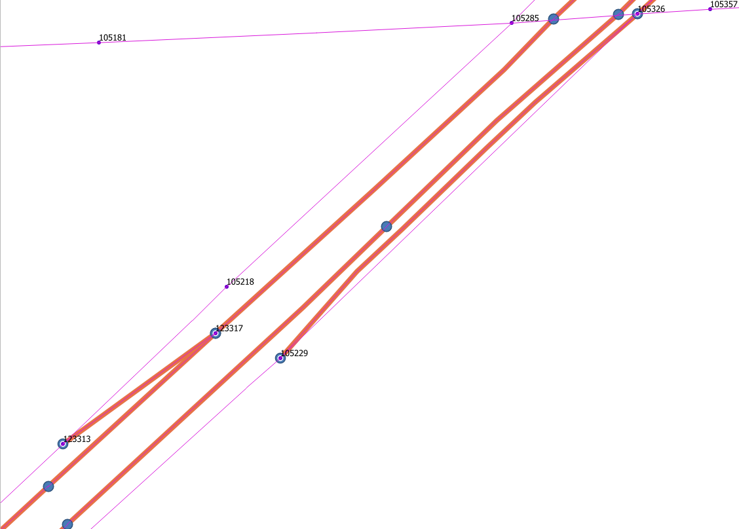
Part – 1: Network Conflation
Network (a section of I-95 EL)
Task 1: A, B nodes
Inputs:
GeoMaster: no A,B
Hwy_NodeIDs: some Nodes have N
Centroid Connectors: some have A, B
Zone Centroids: one direction TAZ
Outputs:
GeoMaster_CC:
one network with both master network links, centroid connectors both directions
Appended A,B nodes:
Hwy_NodeIDs wherever available
TAZ nodes for centroid connectors
Rest of the nodes will get nodes (with starting numbering from the largest existing node number)
Figure:
Small purple dots with Numbers are user specified Hwy_NodeIDs and big Blue dots are missing node numbers

Slide 13
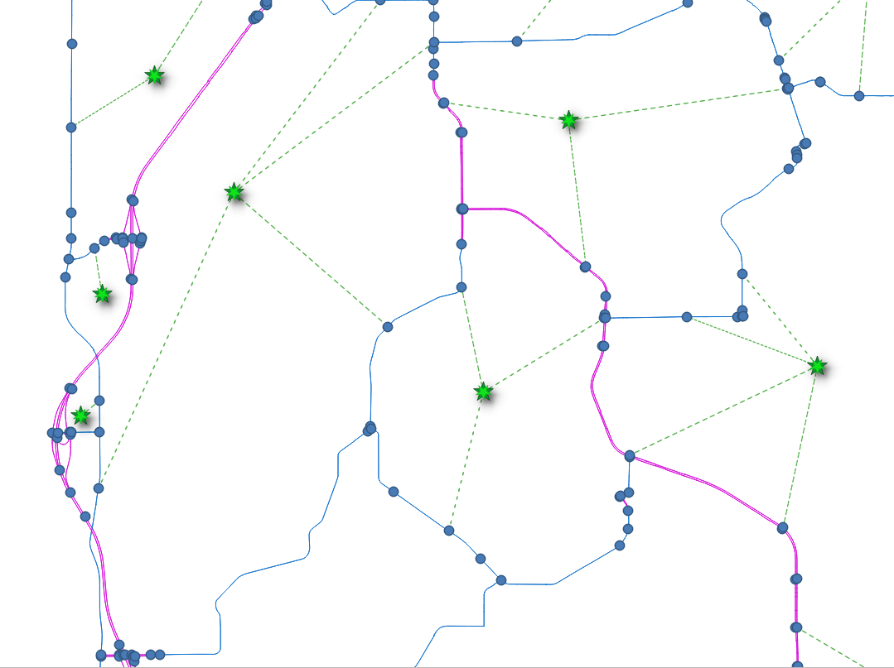
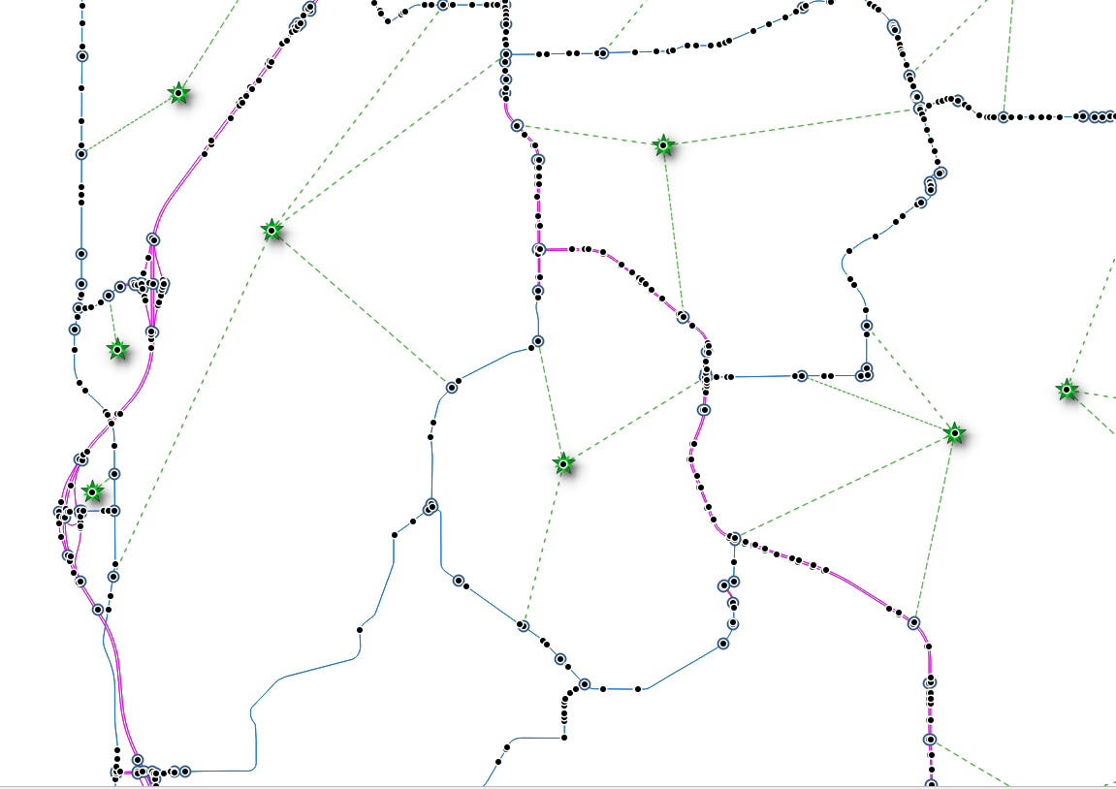
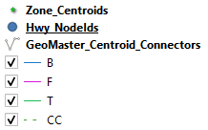
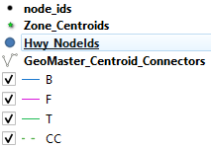
Part – 1: Network Conflation
User Input: Nodes
Program Generated: Node from EndPoints
Program Generated : Endpoints of each line-segment is exported out with X,Y coordinates. Node numbers are read from User Input Hwy_NodeIDs file and Zone_Centroids file. For all other missing nodes IDs, program generates node ids (these are auto generated and so could change from one specification to another). To avoid, program writes back to original inputs so that next iterations uses the same

Slide 14
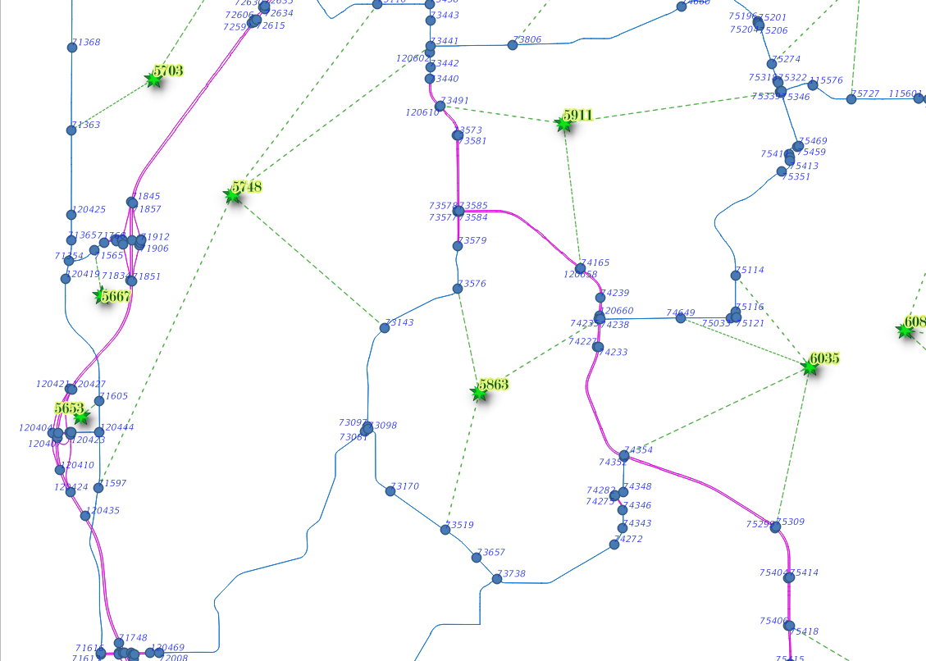
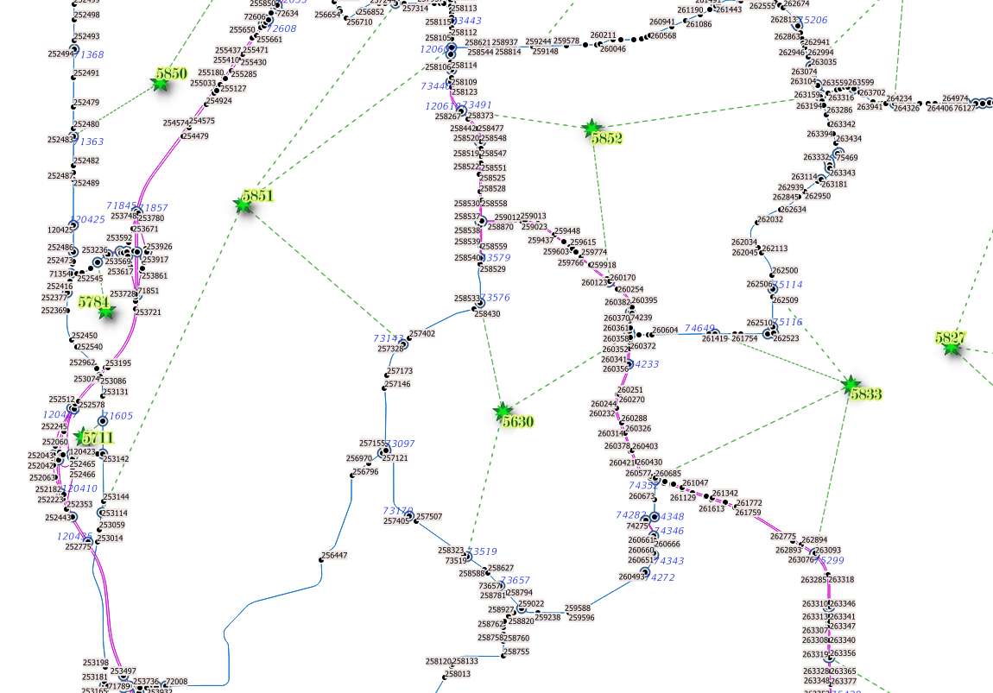
Part – 1: Network Conflation
User Input: Node IDs
Program Generated: Node IDs
Program Generated : Node IDs
Writes back to the Input file, so that user can maintain the same nodes, every time it runs.

Slide 15
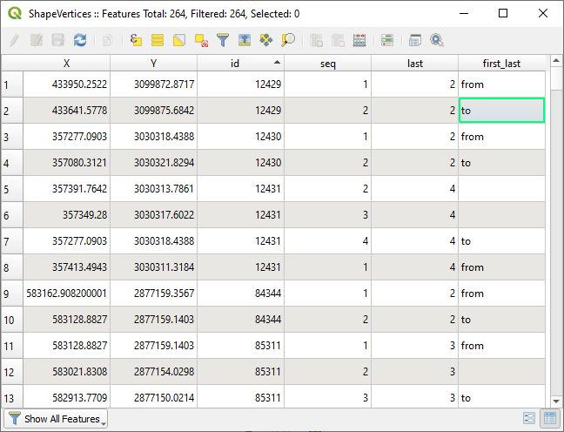
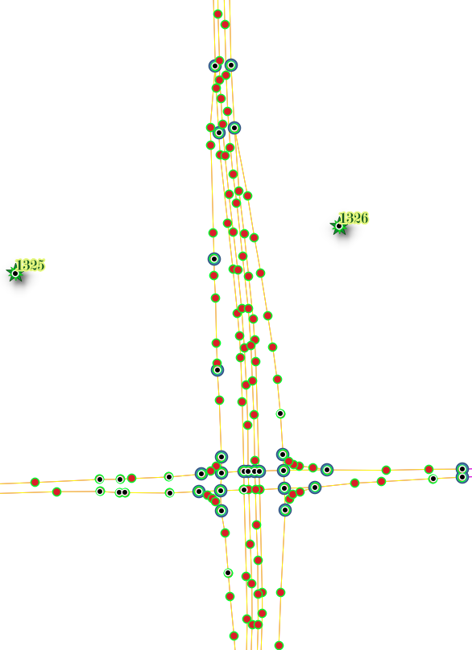
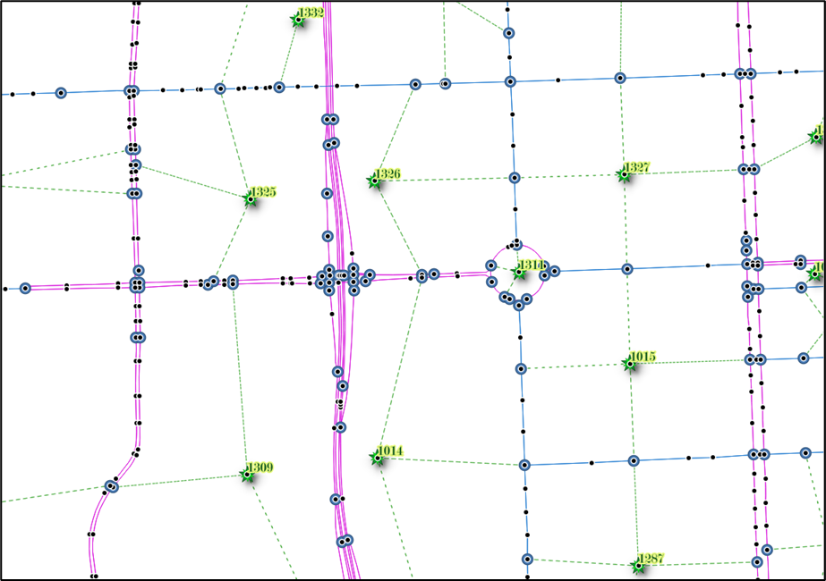
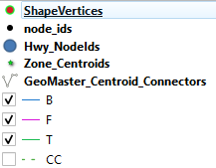
Part – 1: Network Conflation
Program Internals: Not Just Endpoints
Program Internals: All vertices (Shape points)
Program Generated : The program computes the endpoints from shapepoints (shp & shx index)

Slide 16
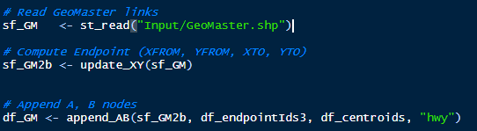
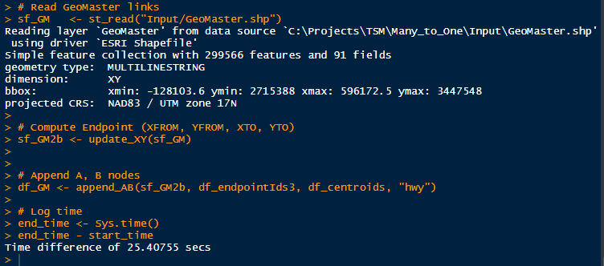
A Look Inside R + SF library + WKT
Script (call to functions):
Two User Functions:
update_XY (), append_AB()
Console (runtime):
Took about 25 seconds to:
Load a shapefile
Convert into sf::wkt format
Run fun #1: Calculates coordinates at both endpoints (walks all the Shape Vertices, finds the first (FROM) and last (TO) in sequence, grabs X,Y)
Run fun #2: Looks at (X,Y) in FROM/TO, looks at respective coords in Node list, centroid list and appends node number as A & B for all links.
All in about 25 seconds

Slide 17
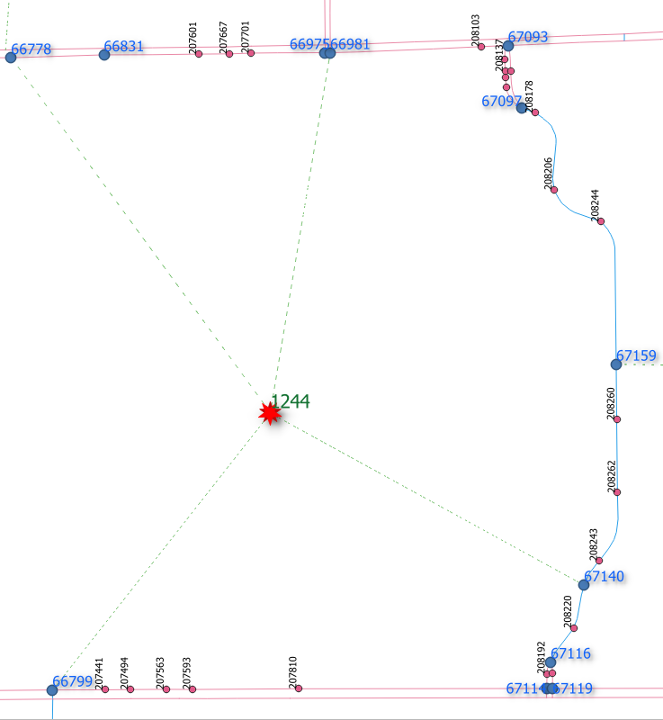
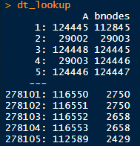
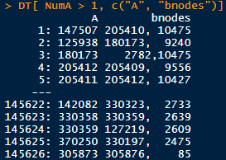
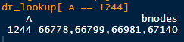
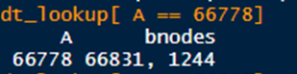
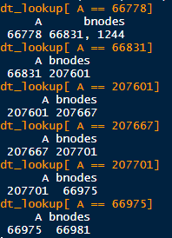
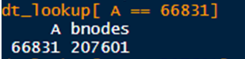
What’s the approach ?
1. Develop current node-> next node (BNode lookup for a given ANode)
No intersections (A -> B)
Intersections (A -> B, A -> C, A -> D)
2. Convert to a searchable list
(current node-> list of next nodes)

Slide 18
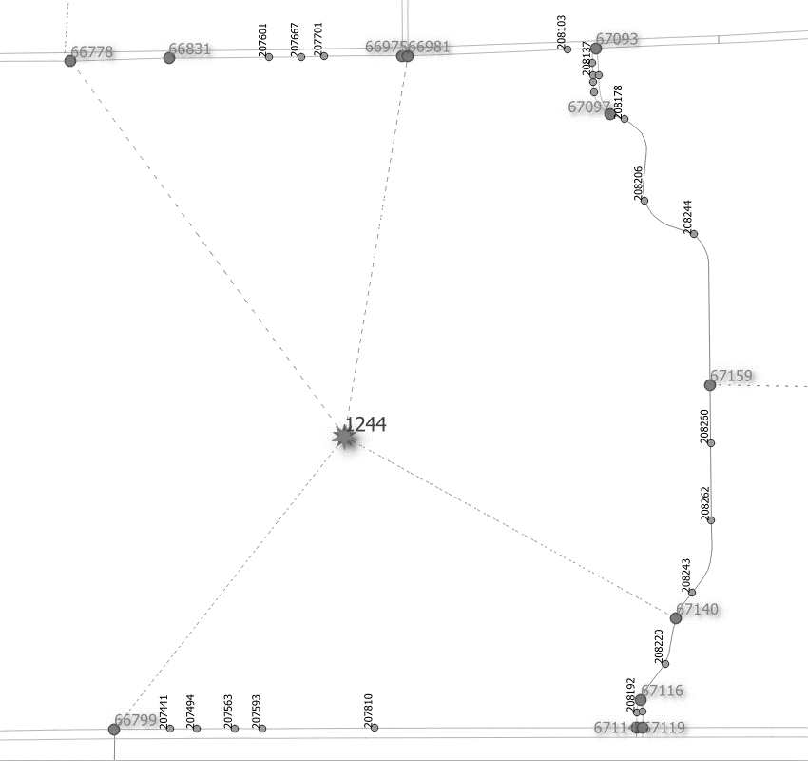
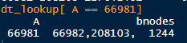
What’s the approach ?
3. Walk the network
(current node-> list of next nodes)
4. Pull Link Attributes
(along with geometry)
Not the same, continue
The same, merge geometries
The same, merge geometries
The same, merge geometries
The same, merge geometries
The same, merge geometries
Not the same, continue

Slide 19
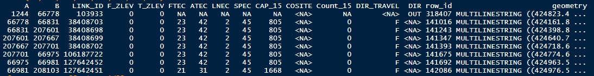
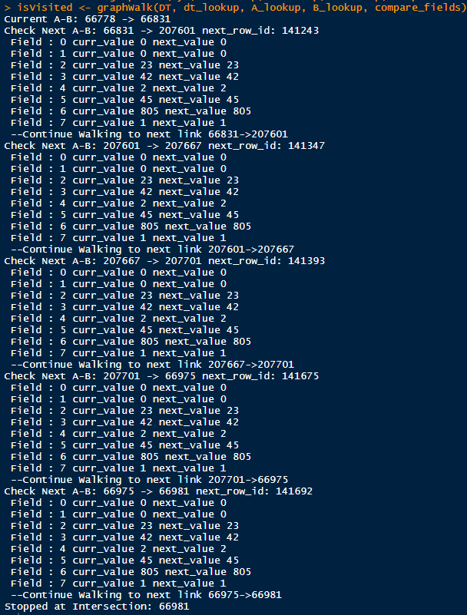
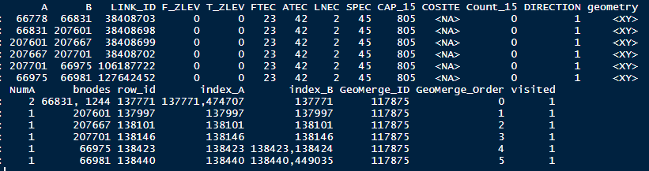
What’s the approach ?
Input: Link Attributes, List of fields to compare
Program Internal Logic:
Gets next B-node
Finds link(s) at B-node
Compares attribute
Assigns consolidate ID and sub-segment sequence id
Required Information for Merging Segments

Slide 20
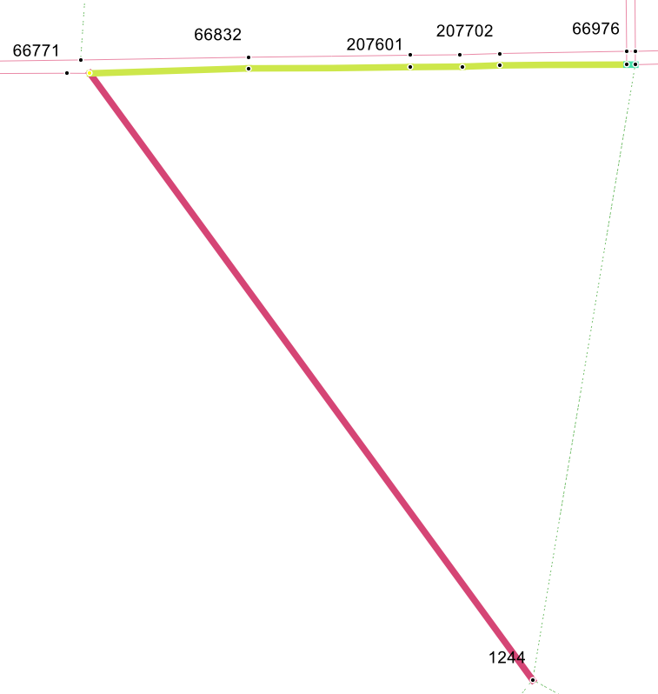
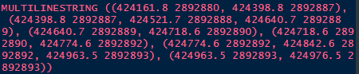
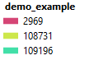
What’s the approach ?
Input: Link Attributes, List of fields to compare
Program Output:
Grabs first A and last B node
Merges Geometry
Writes out single multiline with one row data
Merged Segment

Slide 21
My Criteria Algorithm : (criteria used for identifying related links)

Slide 22
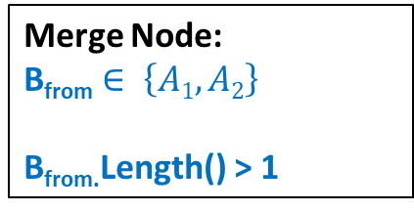
Criteria for Loops & Merge Nodes
Bi-directional
#1: Starting point cannot be the destination
Uni-directional
A
Break Loop:
Seg_Start != next_Bnode
A
#2: Need to look at merge and split links to understand and break the loop
B
Merge Node:
B_{from} $∈ \left\{A1, A2\right\}$
B_{from.}Length() > 1
Next_Bnode
B
B
A-B & B-A are different
A1
A2
A-B & B-A are same

Slide 23
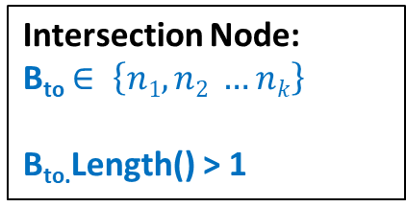
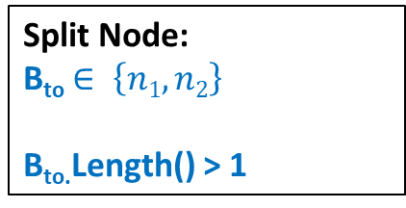
Split Nodes / Intersections
Uni-directional
#3: Split node (divergent links)
#4: Intersections
n1
n2
n2
n2
A
n1
n1
n3
n3
B
B
B
A
A
A
Split Node:
B_{to} $∈ \left\{n1, n2\right\}$
B_{to.}Length() > 1
Intersection Node:
B_{to} $∈ \left\{n1,n2 …nk\right\}$
B_{to.}Length() > 1
B
A-B & B-A are same

Slide 24


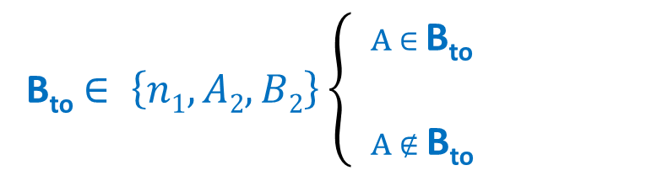
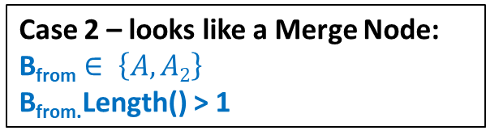
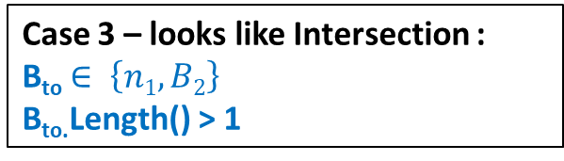


Bi-directional Links vs Merge / Split nodes
#5: Bi-directional Links
Case (1)
Case (2)
Case (3)
Case 1 – looks like a Split Node:
B_{to} $∈ \left\{n1, n2\right\}$
B_{to.}Length() > 1
n1
A2
n1
A2
n1
Case 2 – looks like a Merge Node:
B_{from} $∈ \left\{A, A2\right\}$
B_{from.}Length() > 1
B
n2
n2
B
B
Case 3 – looks like Intersection :
B_{to} $∈ \left\{n1, B2\right\}$
B_{to.}Length() > 1
A
A
B2
A
n2
Solution eliminate reversible links :
Solution eliminate reversible links :
B_{to} $∈ \left\{n1, A2, B2\right\}\left\{\begin{matrix}{ }_{A ∉ \text{B}\text{to} }^{\begin{aligned}A ∈ \text{B}\text{to} \\ \\ \\ \end{aligned}}\end{matrix}\right.$
Bi-directional
If $A ∈\text{B}\text{to}$then compute $A ∉\text{B}\text{`}\text{to}$
B`_{to} $=\text{B}\text{to} −$ A
Uni-directional
B`_{to.}Length() > 1

Slide 25
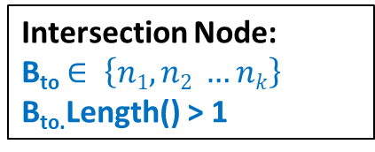
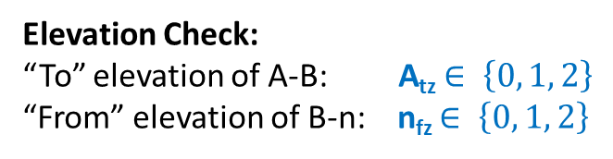

Intersection vs Overpass
Intersection
Overpass
#5: Intersection vs Overpass
Next_Bnode ?
Intersection Node:
B_{to} $∈ \left\{n1,n2 …nk\right\}$
B_{to.}Length() > 1
n2
n2
n1
n3
n1
n3
Elevation Check:
“To” elevation of A-B: A_{tz} $∈ \left\{0, 1, 2\right\}$
“From” elevation of B-n: n_{fz} $∈ \left\{0, 1, 2\right\}$
B
B
A
A
Overpass Node:
$$∃n∈B_{t0}{ : n}_{fz}=A_{tz}$$
There exists an n in set B_{to} whose “FROM” elevation matches to A’s “TO” elevation

Slide 26


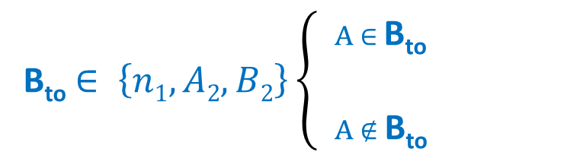
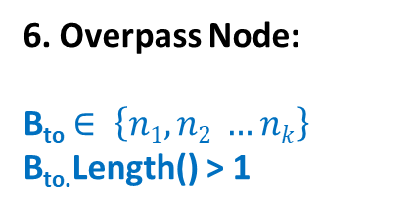
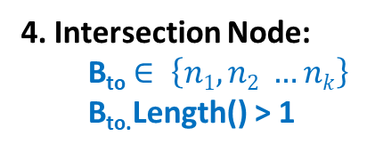




My Search Criteria
1. Break Loop:
Seg_Start != next_Bnode
5. Reverse Bi-directional
Next_Bnode ?
B_{to} $∈ \left\{n1, A2, B2\right\}\left\{\begin{matrix}{ }_{A ∉ \text{B}\text{to} }^{\begin{aligned}A ∈ \text{B}\text{to} \\ \\ \\ \end{aligned}}\end{matrix}\right.$
Bi-directional
2. Merge Node:
B_{from} $∈ \left\{A1, A2\right\}$
B_{from.}Length() > 1
Uni-directional
If $A ∈\text{B}\text{to}$then compute $A ∉\text{B}\text{`}\text{to}$
3. Split Node:
B_{to} $∈ \left\{n1, n2\right\}$
B_{to.}Length() > 1
B`_{to} $=\text{B}\text{to} −$ A
B`_{to.}Length() > 1
4. Intersection Node:
B_{to} $∈ \left\{n1,n2 …nk\right\}$
B_{to.}Length() > 1
6. Overpass Node:
B_{to} $∈ \left\{n1,n2 …nk\right\}$
B_{to.}Length() > 1
$$\left\{\begin{matrix}{ }_{\text{n}\text{fz} ∈ \left\{0, 1, 2\right\}}^{\begin{aligned}\text{A}\text{tz} ∈ \left\{0, 1, 2\right\} \\ \\ \\ \end{aligned}}\end{matrix}\right.$$
“To” elevation of A-B
“From” elevation of B-n
$$∃n∈B_{t0}{ : n}_{fz}=A_{tz}$$

Slide 27
Intro to Algorithm & Data Structures

Slide 28
Intro to Algorithm & Data Structures: what are Algorithms ? & Why we need them ?

Slide 29
Algorithms ?
What are Algorithms?
A sequence of steps / instructions for program to execute
Ex: My Search Criteria Algorithm
Search Algorithms:
For a given A-node (a) find its B-node (b?) in the below A-B Links
Typical Program (linear search) Logic:
Loop every row of A
Check its value is same as “a”
If yes get B at matched position
FUN (A, B, a){
for(e in 1: length(A)){
if(A[e] == a) {
return(B[e])
}
}
}
Time it takes is length of A: n elements takes n time

Slide 30
Algorithms ?
Can we make it faster ?
Binary Search Algorithms ?
Binary Search Program:
Well, assume that A is sorted (for now, but we will cover this later).
Pick a random number “r” between 1 and max elements of A (here its 14).
Check if A[r] = “a”
Break A into two parts: A_top & A_bottom
If higher A[r] > a, now search in the A_top half or else search A_bottom half
Repeat steps 1 – 4
So, we are breaking into half every time we “guess” till we reach the number.
so, its like 4 guess: 14 -> 7 -> 4 -> 2 (4 guesses)
Log base 2: This as reverse of exponent. Say you need you are asking what is x in 2^x = 16. so it’s log2(16).
Generalize it as log(n).
r
r
Runtime: n elements takes log(n) time

Slide 31


Algorithm Runtime Comparison
Linear Search:
Proportional to length of N elements
Runtime is N.
Scalability ?
As the size increase how does it hold?
Binary Search:
It’s only log times of N elements. So, it’s exponentially faster
Runtime is Log(N).
Say double the size, say A-B links are 28
Increases from 14 to 28.
Plot difference for N = 30
Plot difference for N = 300,000
(our network link attribute size)
Increases from 4 to 5
Why ?
Now we have to only guess one extra time to make it more half Log(28) = ~5 times (or 4.8)
Log(300,000) = ~19 times (or 18.1)
Compare: 300,000 vs 19 : n vs log2(n)

Slide 32
Algorithm Runtime Comparison
Ok, but we look links with A & B, not just Anode to get attributes.
Typical Program (linear search) Logic:
Loop every row of A
Loop every row of B
Check its value is same as “a”
Check its value is same as “b”
Runtime: A(n) * B(n) = N x N = N²
Enhancing the code (still linear but smart):
Maybe some enhancement:
Loop every row of A
Check its value same as “a”
Get all rows of A, A` = {a1, a2,..ak}
Loop over subset A`, which is size k
Check its value as b.
Algo Powered Program (binary search) Logic:
Search for A in halves, log(N).
Search for B in A’ (subset of A) of size k and that takes log(k)
Runtime: log(n) + log(k)
Runtime: A(n) * B(k) = k x N = kN

Slide 33


Algorithm Runtime Comparison
Linear Search:
Proportional to length of N x N elements
Runtime is N²
Enhanced Linear”
Some constant times N
Runtime is kN
Binary Search:
It’s only log times of N elements. So, it’s exponentially faster
Runtime is Log(N)+Log(k)
Linear search is not even in the picture with 90 Billion (y-axis).
N = 30:
Enhanced program helps
but is it good enough for 300,000 links ?
Enhanced program
logic helps
Enhanced Program Runtime:
4 * (300,000) = ~1.2 Million
Enhanced program
still takes a long time
Binary Runtime:
log2(300,000)+log2(4) = ~21 (20.19)

Slide 34
Intro to Algorithm & Data Structures: Ok, so what are data structures? & Why we need them if we have Algorithms ?

Slide 35



Data Structures
Recollect, for Binary search, we assumed “A nodes” are sorted. For this property to hold, we need a data structure that works like that. See Std::Vector but we need more than one value to hold
List <Anodes> = <List of Bnodes>;
ex: (66981, <66982, 208103>)
Vectors are preferred but cannot hold a list of elements. Unless it’s a map. <int, list> which is same as above
Create a new Data Structure similar to map :
In C++ (RCPP), we store data in an indexed structure, where the index of the lookup is defined by “Ordered”. For example list all B-nodes by A’s index.
The internal C++ runs the “binary search” for us when we run index. This is what makes the “My Criteria Algo” fast.

Slide 36

Data Structures
New data structure:
With new <key, value> paired we can store sorted A-nodes with list of B-nodes for each row
ex: (66981, <66982, 208103>
66983, <66, 208, 408, 59>)
A
List of B-nodes
AB Link Search Algorithm: To find “A-B index” or row
Standard find function with this new data structure:

Slide 37



Data Structures: Performance Comparison
Standard Vector type: “Linear Search” on two variables (A,B)
Std:: Vec
New Mapped List Data Type: “Linear Search” on two variables on two variables (A,B)
Custom:: List

Slide 38
Graph Theory & Graph Search Algorithms: What is a graph? & how is a graph searched?

Slide 39



Basics of Graph Theory
Not just Roadway Networks, a lot of applications exist
Roadway Networks

Slide 40



Basics of Graph Theory
Graph
This is why we created a new data type to store list of bnodes to work with our Algorithm
https://www.khanacademy.org/computing/computer-science/algorithms

Slide 41



Key Differences
Basics of Graph Theory: Traversing Algorithms: BFS vs DFS
ELToD Application
This Application
https://en.wikipedia.org/wiki/Breadth-first_search
https://en.wikipedia.org/wiki/Depth-first_search
https://www.geeksforgeeks.org/difference-between-bfs-and-dfs/

Slide 42

Basics of Graph Theory: Traversing Algorithms: BFS vs DFS
TSM NextGen : GeoMaster / Centroids
ELToD Application
This Application
Goal:
We are trying to build a shortest path
BFS:
Exhaust all neighboring nodes first to find which one offers the best utility.
Goal:
We are trying to build a connected node list
DFS:
Exhaust all connected nodes until we hit an intersection.
BFS: We also use BFS to search for
Merge links: For a given TO node, where are the FROM nodes.
Intersections vs Under / Overpass

Slide 43

Runtime:

Slide 44
Program Checks:

Slide 45


Program Insights:
Program log file
Network: Consolidation A -> a1 -> B
A
a₁
B

Slide 46




Program Insights:
Program log file: Identifies and classifies various types of intersections
Network: Overpass A -> (a1 … a6) -> B
B
a₁
a2
A

Slide 47


Program Insights:
Tool Comparison:
About 6,908 CUBE links are further consolidated to 3,470 links in the new tool.
Due to duplicate nodes, there are 7230 links that show up with different A-Bs while same geometry

Slide 48


Program Insights:
Tool Comparison:
Red and blues are two segments in the current tool (CUBE base links)
The new MTO tool merges both as it see fit

Slide 49




Program Insights:
Current Tool: Multiple Overpass Segments
New Tool: Single Overpass Segments

Slide 50
Input Data Issues:

Slide 51



Notes: Uni-directional Coding
The GeoMaster, centroid connectors are coded in one-direction “Uni-directional “.
This reduces the amount of computation by half
The reverse direction is typically computed on the consolidated network
Issue: On a bi-directional link, we are assuming same attributes for both directions (generally it’s ok but not for micro DTA).
Solution #1:
Code automatically identifies such locations and
creates a reversible link, forcing an intersection.
Code complication but quick -
Solution #2:
Automatically code, the reverse direction in all bi-directional links. Preparation step handles this (can be done in R) instead of C++.
Adds ~130k more links to process, slight increase in runtime is expected.
Uni-directional coding issues with Loop and Roundabouts:
Since there is NO 37204 -> 142907 to break the loop by creating an intersection, the program enters an indefinite loop

Slide 52
Notes:
For Walk-the-Graph to work, the network link segments should be in the same direction between the intersections.
Ex: A -> x -> y -> z -> B will produce A -> B
Ex: A -> x -> y <- z -> B will produce A -> y, y ->z and z -> B
Correct
Incorrect
B
B
B
B
z
y
z
y
z
y
x
x
A
A
A
A

Slide 53


Input Issues #2: Sequence is not consistent
For Walk-the-Graph to work, the network link segments should be in the same direction between the intersections.
Ex: Links 115058 -> 198634 and 62892 -> 198634 both are in opposite directions. This results in not margining two links, while the Blue dots shows the expected merge section

Slide 54


Input Issues #2: Programmatically Flag
Logic to identify inconsistent links (ex: D -> E <- F)
Find all "A" nodes with no "From“ nodes (ex: "E" above) and
Check against Unique B nodes, flag them as missing “From” end
Append it flags back to all links keyed on “B” to get all links
There are 10, 077 inconsistent link out of 300,145 (~3.35%)
Half of them need to be reversed
140 are one-way links. These are real problem as there won’t be a reverse direction

Slide 55

Input Issues #2: Programmatically Flag
There are 10, 077 inconsistent link out of 300,145 (~3.35%)
Half of them need to be reversed
No easy fix:
No automatic fix:
- Some network conflation tools can be used but consumes same amount of time as manually reviewing these 10k links
Solution:
Code all reverse direction for all bi-directional links. Handle reverse (BA) link internally in the program

Slide 56

Input Issues #3: Multiple Nodes
Centroid Links (endpoints) and Zone Centroids should be snapped. Currently, about 207 centroids don’t snap.
Hwy_NodeIds (points) and GeoMaster Links should also be snapped. Currently everything works well
Duplicate nodes
Solution #1:
Keep the lowest number and remove the other two. ArcGIS “Many-to-One” Addin doesn’t really have an order, it keeps uses the first node it encountered. This logic is hard to replicate as each program assigns “shp” data handles in different ways. Tried but it didn’t produce the same results as ArcGIS
Solution #2:
Manually cleanup – decide what’s retained at the end of “Many-to-One” tool and correct the input.
Prefer automatic cleanup, keeping the lowest number and overwrite the input database.

Slide 57

Input Issues #4: Missing Links
Navteq Database:
This link exists but coded with a different functional class than other links.
GeoMaster:
It appears, GeoMatser is developed with a generalized idea (Navteq functional class of major & secondary roads) and appreantly no QA/QC.
Links to 87797 is missing

Slide 58


Input Issues #5: Inconsistent Elevation
50594 -> 114231 shows an elevated section
114231 -> 50754 shows at grade to elevation
This suggest perhaps ZLEV is coded in reverse ?
Solution: Program to evaluate all such inconsistencies and flip the T_ZLEV and F_ZLEV

Slide 59


Input Issues #5: 3-Level Overpass
Only two locations show 3 level

Slide 60

Input Issues #5: Overpass Inconsistency
Overpass:
There are only 1911 overpass nodes?
Overpass nodes are defined as nodes (intersections) with both at-grade and grade-separated links.
What are not overpass nodes:
Ground nodes: both ends at-grade
Elevated nodes: Both ends with grade-separated.
Elevated Ramps: One end with at-grade and the other end grade-separated.

